Slide 2
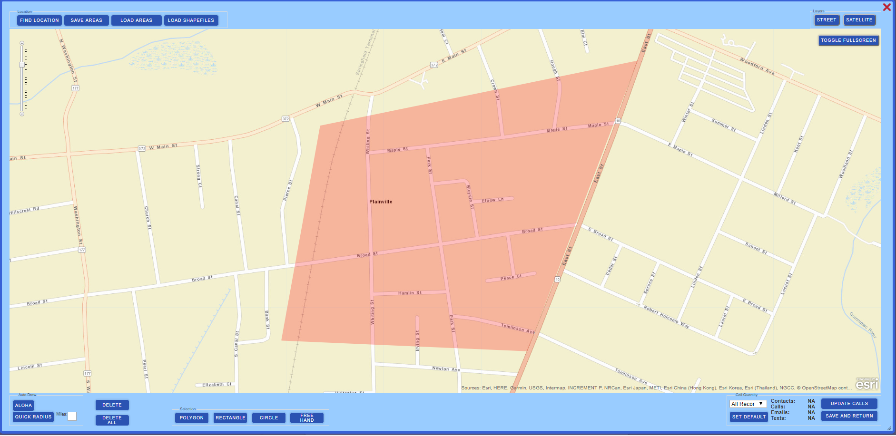
Sangamon Alert Messaging Tool (SAM)
What is it?
Our emergency mass notification conveyance system
Used by thousands of communities nationwide
Reliable voice, text, email, social media and mobile app alerts
Geographic Notifications
Staff alerting
Immediate implementation
Real-time statistics

Slide 3
How it Works
Training will be offered by OnSolve and Sang. Co. OEM via Webinars and classroom instruction

Slide 4
How can you use SAM?
Municipalities
Evacuation notices and routes, gas leaks, boil orders
Public Works
Planned and unplanned construction projects, paving announcements, road closures, etc.
Internal Staff Notification
First responder notifications, police staffing quotas, two-way messaging, emergency/critical incident call out

Slide 5
How can you use sam
Schools
Emergency Days/School Closings
Communications with district during and after a major incident
Notification to premade list of substitutes of a need for the day (system allows two way messaging so you can receive a response to a message sent to substitute teacher list).
If you already have a system in place for notifications, consider SAM your mass notification tool for emergency messages.

Slide 6
What NOT to use for
Sangamon Alert Messages are intended to be used for instances where the safety of the public is at risk.
Should not be used for day to day activity: bake sales, town garage sales etc.
Should not be used for any political reason.
Should not be used to duplicate a message that has already been sent out by the County or any other entity.

Slide 7
“Sub” Accounts”
The main account is managed by the County, sub account is given to authorized user for their area.
Only the County Board or a designee may assign a sub account.
Sub accounts must follow the County Policy for sending messages.
Main goal is to keep the public informed while not overusing the system by sending too many messages. We do not want to use it so often that citizens turn it off or block notifications from it and miss out on true emergency notifications.

Slide 8
Questions?
Sangamon County Office of Emergency Management
Attention: Bill Lee
217.747.5101
bill.lee@co.sangamon.il.us

